Slide 1
MAJOR PROJECT PRESENTATION
TITLE
ONLINE ATTENDANCE BASED SYSTEM USING QR CODE AND IMAGE RECOGNITION
Project Mentor - Mr. Surender Singh
Team Members -
Dishank Aggarwal(40415003117)
Deepanshu Mathur(35215003117)
Tina Ohri(02615003117)
Khushboo (01115003117)

Slide 2
Overview of the project
Here we will be creating an online attendance management system using QR code recognition and image recognition.
For marking a student’s attendance :-
A list of students will be identified by the system in .txt format.
Different QR codes will be generated for each student in the list.
Those codes will be provided to the respective students.
As a next step in process, camera will be used for QR code scanning.
Then QR code recognition will come into picture, it will recognize the scanned QR code and analyze whether the data is present in the given list.
Attendance will get marked once data verification is done. If the student has already marked the attendance, he will get the notification for the same, else attendance will be marked.

Slide 3
REQUIRED SOFTWARE COMPONENTS
Python
Tkinter
Opencv
Image_recognition
Base64 encoding
Pyzbar

Slide 4
PROJECT TASK IS CLASSIFIED INTO FIVE SUB PARTS :-
ENCODING DECODING
QR CODE GENERATION
GUI CREATION
QR CODE RECOGNITION
IMAGE RECOGONISATION
ATTENDANCE MARKING

Slide 5
QR code generation
A QR code (Quick Response code) is a type of matrix barcode. A barcode is a machine-readable optical label that contains information about the item to which it is attached. In practice, QR codes often contain data for a locator, identifier, or tracker that points to a website or application. A QR code uses four standardized encoding modes (numeric, alphanumeric, byte/binary) to store data efficiently.
Few advantages of using QR codes :-
Quick and error free
More informative
Engaging with rich content
Easy to save
Uniquely Identifiable

Slide 6
Base64 encoding
The format information records two things: the error correction level and the mask pattern used for the symbol. Masking is used to break up patterns in the data area that might confuse a scanner, such as large blank areas or misleading features that look like the locator marks. The mask patterns are defined on a grid that is repeated as necessary to cover the whole symbol. Modules corresponding to the dark areas of the mask are inverted. The format information is protected from errors with a BCH code, and two complete copies are included in each QR system.
The general structure of a QR encoding is as a sequence of 4 bit indicators with payload length dependent on the indicator mode on each QR symbol.

Slide 7
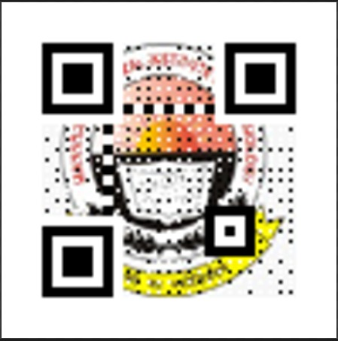
QR code generation screenshot

Slide 8
GUI creation
Graphical user interface (GUI) - A graphical user interface (GUI) is an interface through which a user interacts with electronic devices such as computers and smartphones through the use of icons, menus and other visual indicators or representations (graphics).
Graphical user interfaces allow users to interact with computers using a mouse and other input tools. They give developers more freedom with how they display information, images and other elements.
Good User Interface Design can make a product easy to understand and use, which results in greater user acceptance.
Here we have created Graphical User Interface for better visualization and clear understanding of the system to the students.

Slide 9
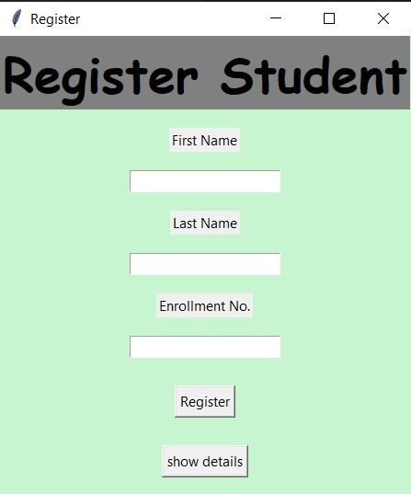
REGISTERING A NEW STUDENT

Slide 10
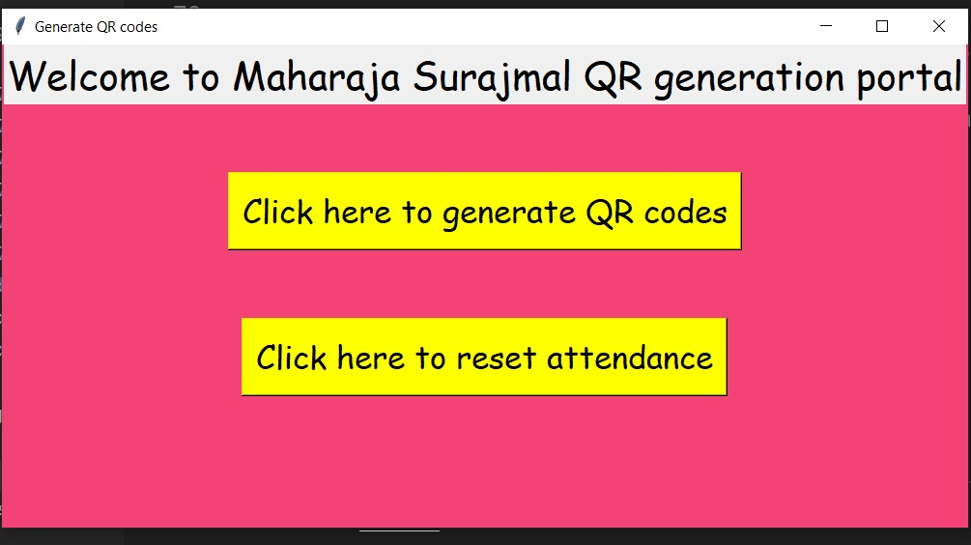

Slide 11
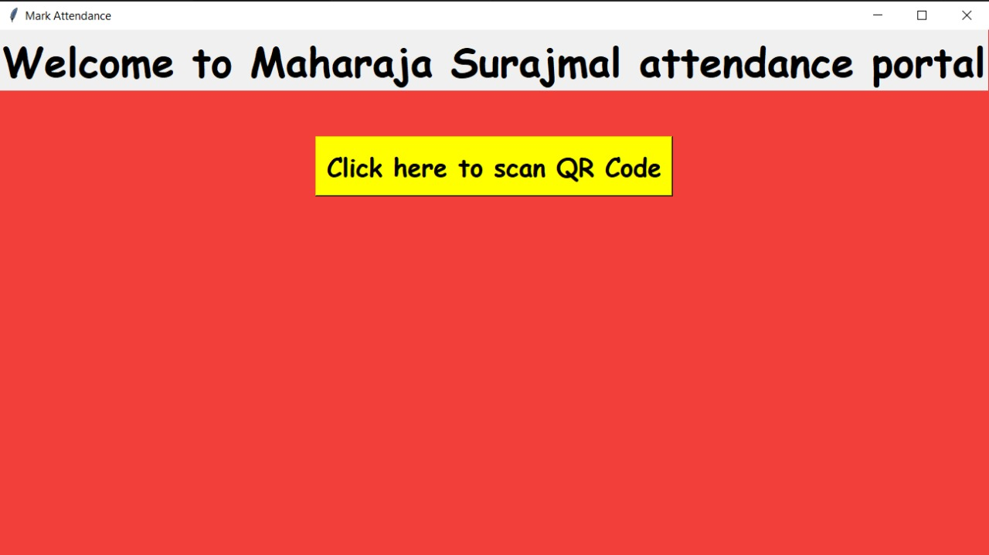

Slide 12
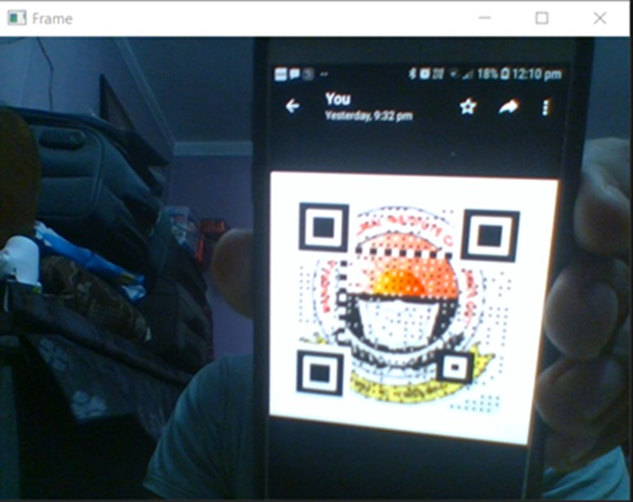

Slide 13
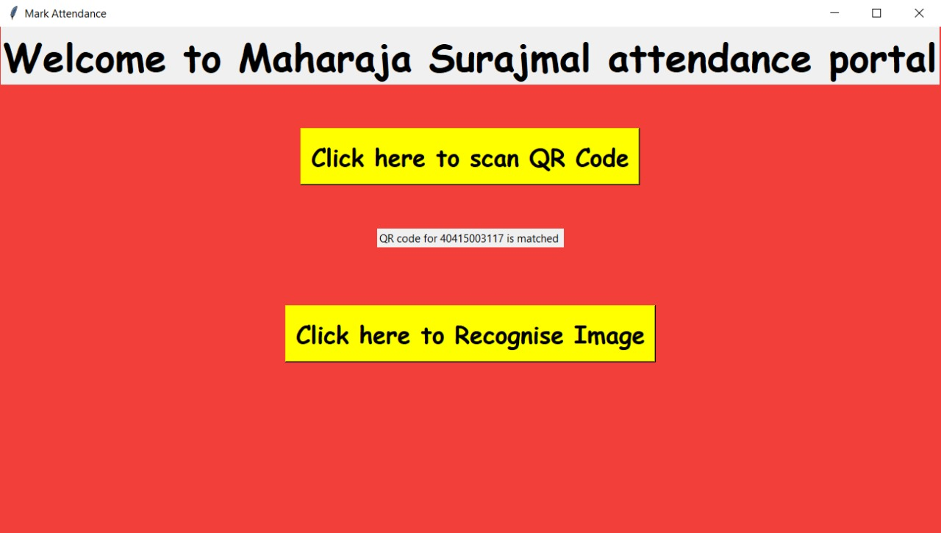

Slide 14
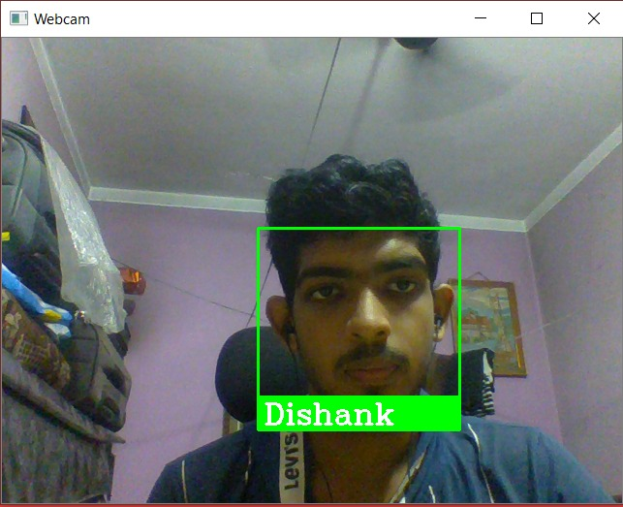

Slide 15
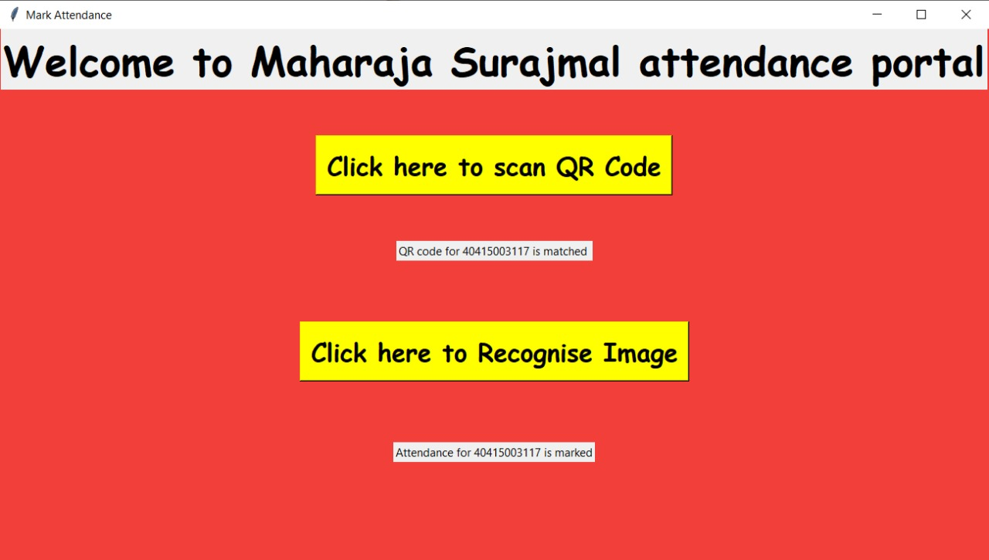

Slide 16
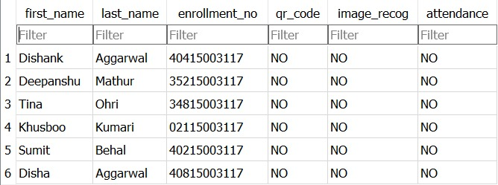
Database before attendance

Slide 17
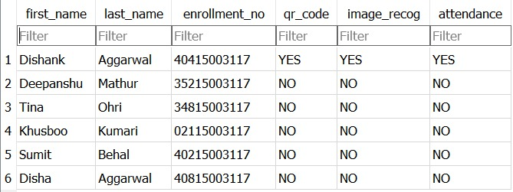
Database after attendance

Slide 18
THANKYOU...

